Slide 1


NCP Enabling Auditable Autonomy
Published by: Mathias Lechner ; Ramin Hasani et al
Published at: Nature Machine Intelligence
Presented by: Aayush Jannumahanti

Slide 2
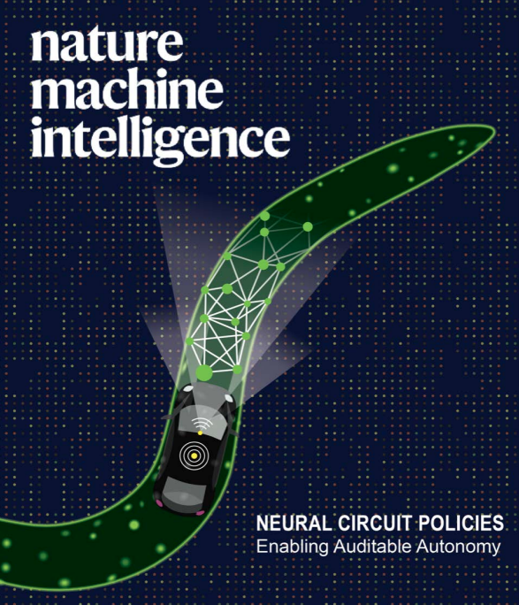
‹#›
Neural Circuit Policies (NCPs) are designed sparse recurrent neural networks loosely inspired by the nervous system of the organism C. elegans.
“The nematode C. elegans, for example, lives its life with an amazingly small number of neurons, and still shows interesting behavioral patterns. This is due to the efficient and harmonious way the nematode’s nervous system processes information.” - Prof. Radu Grosu
The main building block is a Recurrent neural network called liquid time constant (LTC) introduced in (Hasani et al. 2020)
UMBC VLSI-SOC GROUP
Notes:
https://ist.ac.at/en/news/new-deep-learning-models/ IST Austria news article
https://www.sciencedaily.com/releases/2020/10/201013124054.htm science daily news article

Slide 3
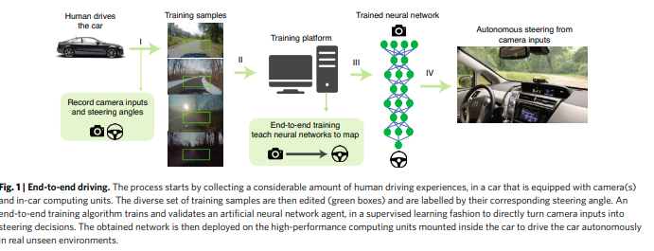
‹#›
Ran a few basic NCP Models
NCP Bacis - https://bit.ly/3Ij62Iy
LTC CELL PyTorch - https://bit.ly/413V8hc
NCP Stacked with other architectures - https://bit.ly/3jRMbXm
dataset obtained from 2D LiDAR sensors https://www.sick.com/ag/en/lidar-sensors/2d-lidar-sensors/lms1xx/c/g91901
They set out to design a brain-inspired intelligent agent that learns to control an autonomous vehicle directly from its camera inputs end-to-end learning to control
UMBC VLSI-SOC GROUP

Slide 4
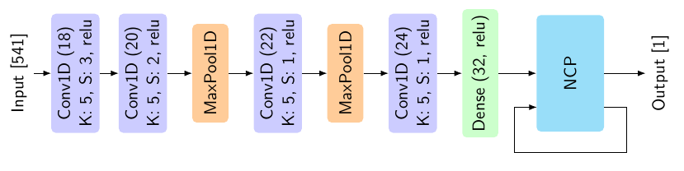
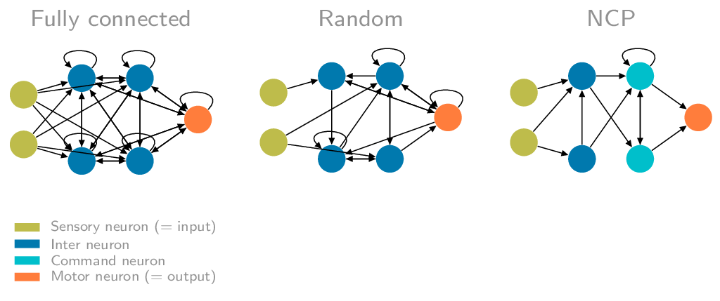
‹#›
Architecture Of Vanilla NCP’s
NCP’s for enabling auditable autonomy github implementation in PyTorch and TF https://github.com/mlech26l/keras-ncp
Wiring of neurons (architecture)
UMBC VLSI-SOC GROUP

Slide 5
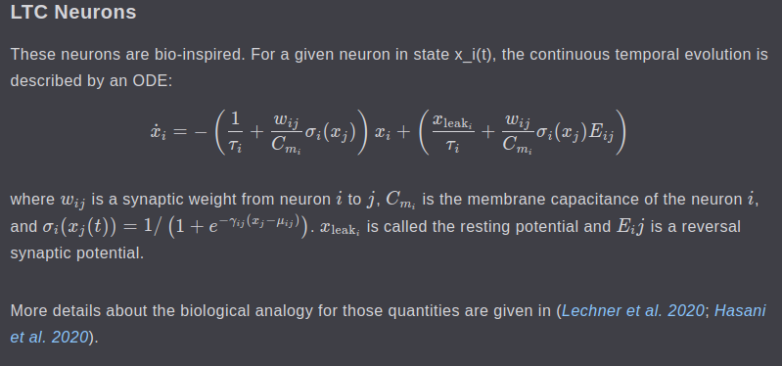
LTC Neurons described by an ODE
UMBC VLSI-SOC GROUP

Slide 6
‹#›
Few implementations to get started
NCP Basic example https://ncps.readthedocs.io/en/latest/
LTC Model with NCP Wiring https://ncps.readthedocs.io/en/latest/examples/torch_first_steps.html
Training an NCP for playing Atari game as a combination CfC recurrent neural network and final linear layer https://ncps.readthedocs.io/en/latest/examples/atari_bc.html (Atari Behaviour Cloning)
Training an NCP to play Atari through Reinforcement Learning. Code is provided for TensorFlow and relies on ray[rllib] (simulated environment like OpenAI Gym framework) for the learning. The specific RL algorithm they are using is proximal policy optimization (PPO) which is a good baseline that works for both discrete and continuous action space environments https://ncps.readthedocs.io/en/latest/examples/atari_ppo.html
UMBC VLSI-SOC GROUP

Slide 7
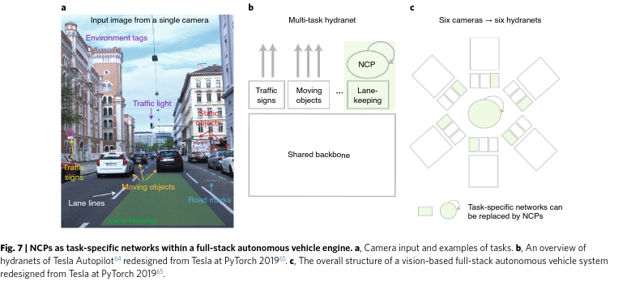
‹#›
Fullstack NCP paradigm provided in the paper, where camera inputs are examples of tasks
Andrej Karpathy giving a talk on Tesla’s autopilot (good to know information)
https://youtu.be/oBklltKXtDE
UMBC VLSI-SOC GROUP

Slide 8
‹#›
Results and Comments
The authors reports good results on a car steering task compared to many RNN architectures, although not much better than LSTMs. The main advantages of this method according to the authors are: Better noise robustness Better interpret-ability, Less parameters needed
This paper because it seemed to have found a way to train very small neural networks with an alternative learning mechanism, maybe akin to reservoir computing. However it appears to be based on the same principles as traditional supervised learning. The main innovation of this paper would therefore be the architecture it proposes, which I may not understand very deeply due to lack of knowledge in neuroscience.
https://hugocisneros.com/notes/alternative_learning_mechanisms/
https://hugocisneros.com/notes/reservoir_computing/
https://hugocisneros.com/notes/lechnerneuralcircuitpolicies2020/
UMBC VLSI-SOC GROUP
Notes:
The approach they follow is to visualizing image classification models and saliency maps using https://arxiv.org/pdf/1312.6034.pdf

Slide 9
‹#›
Useful Links
http://www.raminhasani.com/publications/ Ramin Hasani’s portfolio
https://ti.tuwien.ac.at/cps/people/grosu/files/ncp-grosu-nmi.pdf NCP Talk by Radu Grosu
https://hugocisneros.com/ Hugo Cisneros’s Portfolio
https://github.com/mlech26l Mathias Lechner’s Github for possible NCP Implementations
https://github.com/raminmh Ramin Hasani’s Github
https://www.tesla.com/autopilot Tesla’s Autopilot
https://bit.ly/3Xs9dSu My list of papers pertaining to NCP’s
UMBC VLSI-SOC GROUP

Slide 10
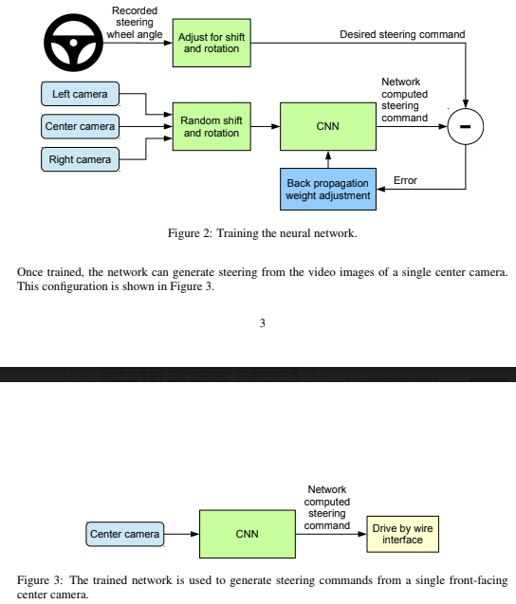
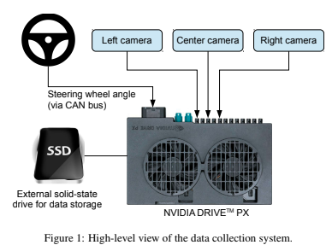
‹#›
Few similar Implementations
This steering command is obtained by tapping into the vehicle’s Controller Area Network (CAN) bus. In order to make our system independent of the car geometry
Link to NVIDIA paper on end to end learning https://bit.ly/3E4wDX3
UMBC VLSI-SOC GROUP

Slide 11
Thank you
‹#›
Questions?
UMBC VLSI-SOC GROUP

